Slide 1
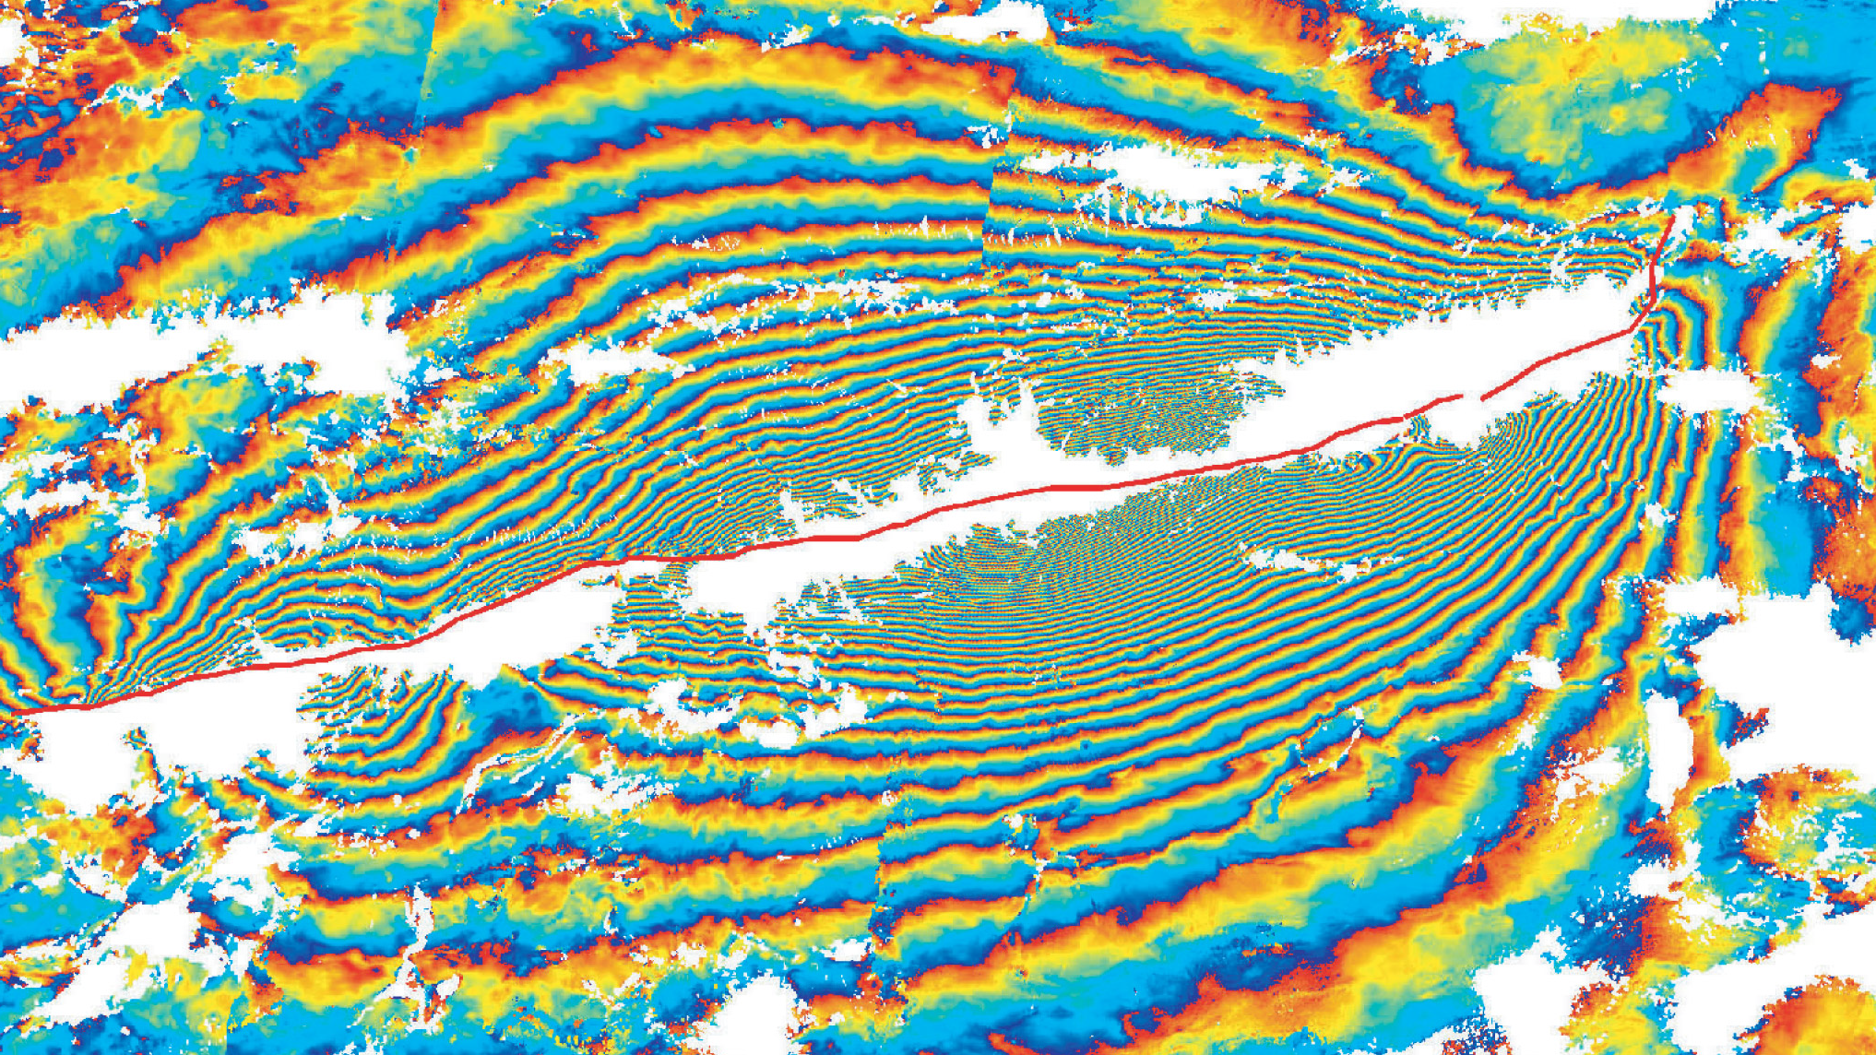
An introduction to geophysical modeling of geodetic data
Gareth Funning, University of California, Riverside

Slide 2
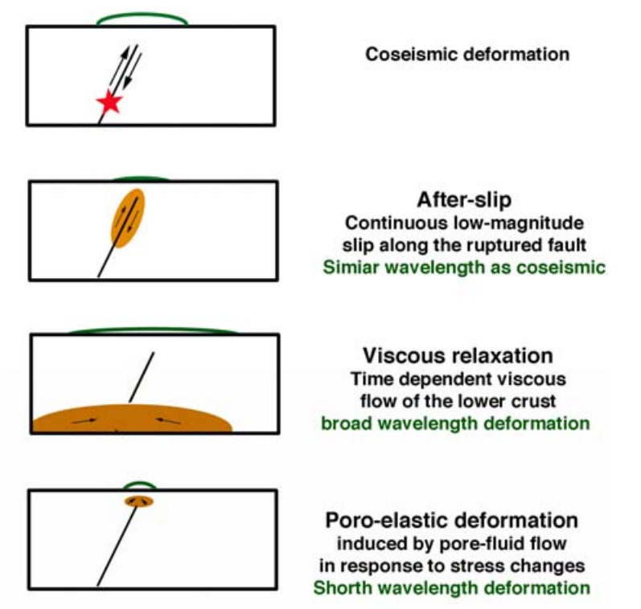
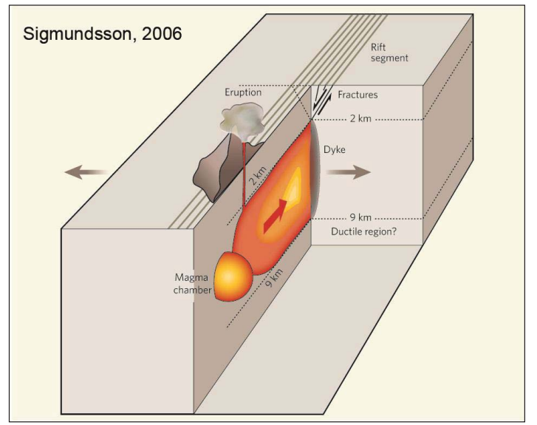
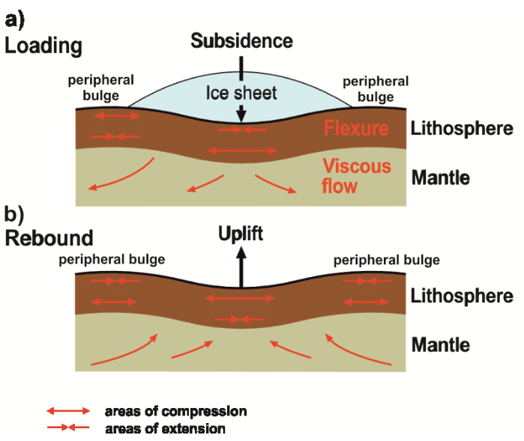
By geophysical modeling, we mean using idealized representations of the Earth to gain insight into its properties and processes

Slide 3
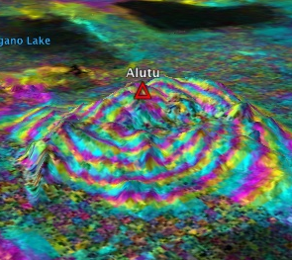
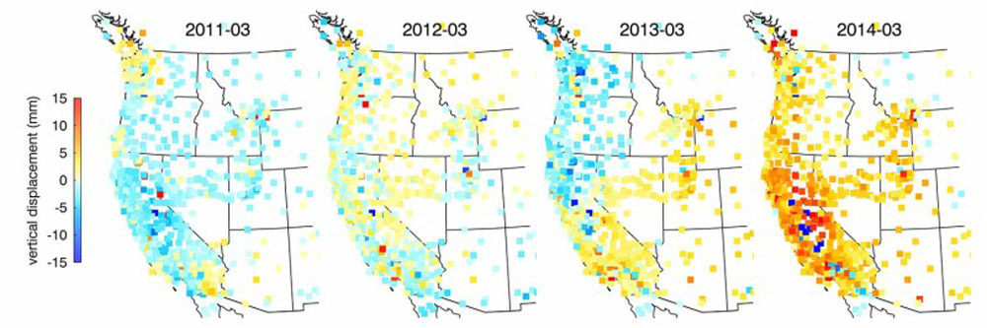
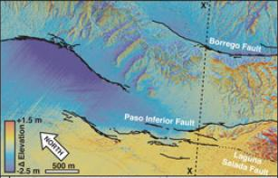
By geodetic data, we mean data that measure deformation (changes in shape) of the Earth’s surface – e.g. InSAR, GPS/GNSS, differential lidar, optical image correlation…

Slide 4
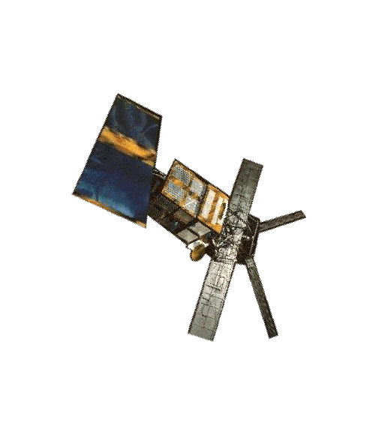
An individual SAR interferogram measures deformation in one dimension, in the radar line-of-sight
phase=φ₁
phase=φ₂
phase shift due to ground motion
Pass 1: pre-movement
Pass 2: post-movement

Slide 5
An individual SAR interferogram measures deformation in one dimension, in the radar line-of-sight
phase=φ₁
phase=φ₂
φ₂-φ₁ negative: range decrease
Pass 1: pre-movement
Pass 2: post-movement
Line-of-sight direction
φ₂-φ₁ positive: range increase

Slide 6
Vector description of InSAR
u = ground displacement vector
p = pointing vector (from satellite to ground target)
p is controlled by the satellite trajectory, beam mode (incidence angle) and position of the pixel within the swath
p
u

Slide 7
The unit pointing vector
u = ground displacement vector
p = unit pointing vector (from satellite to ground target)
^
^
p
u

Slide 8
Range change
^
the scalar (dot) product of u and p is the ‘range change’ (r) we measure in interferograms
u
θ
r
^
p
therefore, the key to modeling InSAR data is having a code that can simulate the displacements u
cross-section view

Slide 9
WARNING
Historically, people did not all use the same sign conventions in InSAR (including me…)
Check whether your interferograms are ‘range change’ or ‘ground LOS displacement’
Check if your pointing vectors are consistent with your interferograms (pointing from satellite to ground, or ground to satellite?)
If your reference image is the earlier of the two images, your interferogram should be in range change

Slide 10
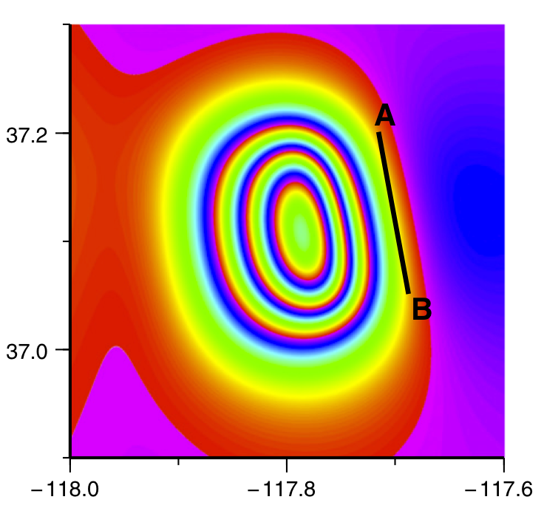
A forward model is a simulation of what InSAR would measure for a given set of model parameters
d’ = G(m)
model parameters (location, model geometry, size, etc)
simulated data
model theory (and InSAR geometry)
strike: 172°, dip: 38°, rake: –95°

Slide 11
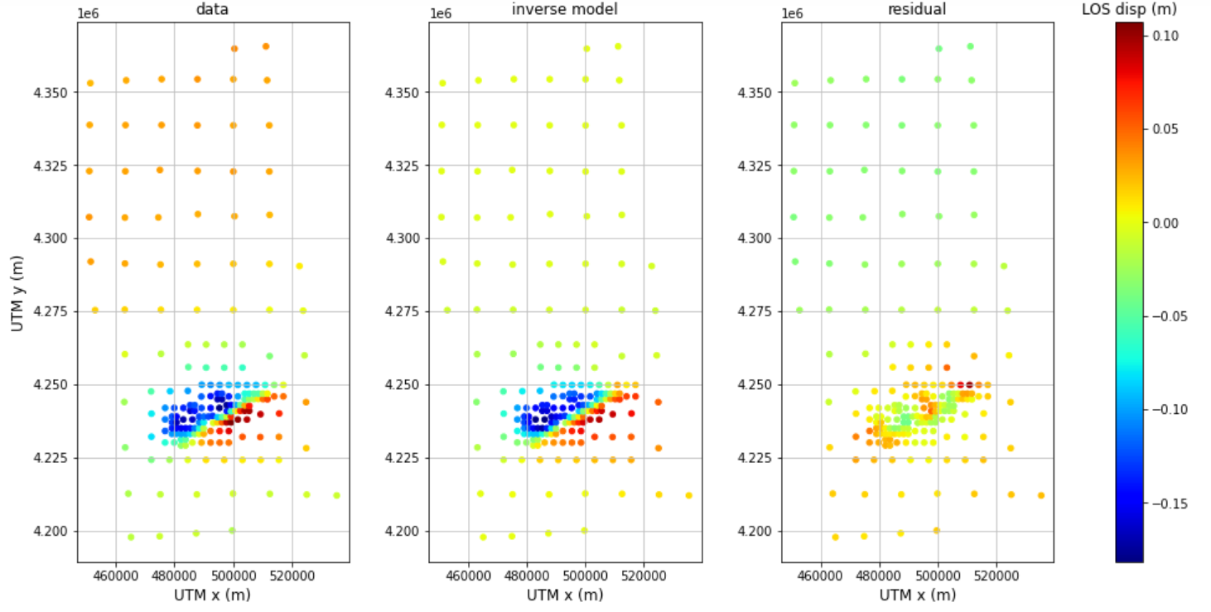
Inverse modeling involves using observed data to estimate the most appropriate model parameters
data
model
data-model
m' = G⁻¹(d)
observed data
estimated model parameters
inverse of the theoretical model

Slide 12
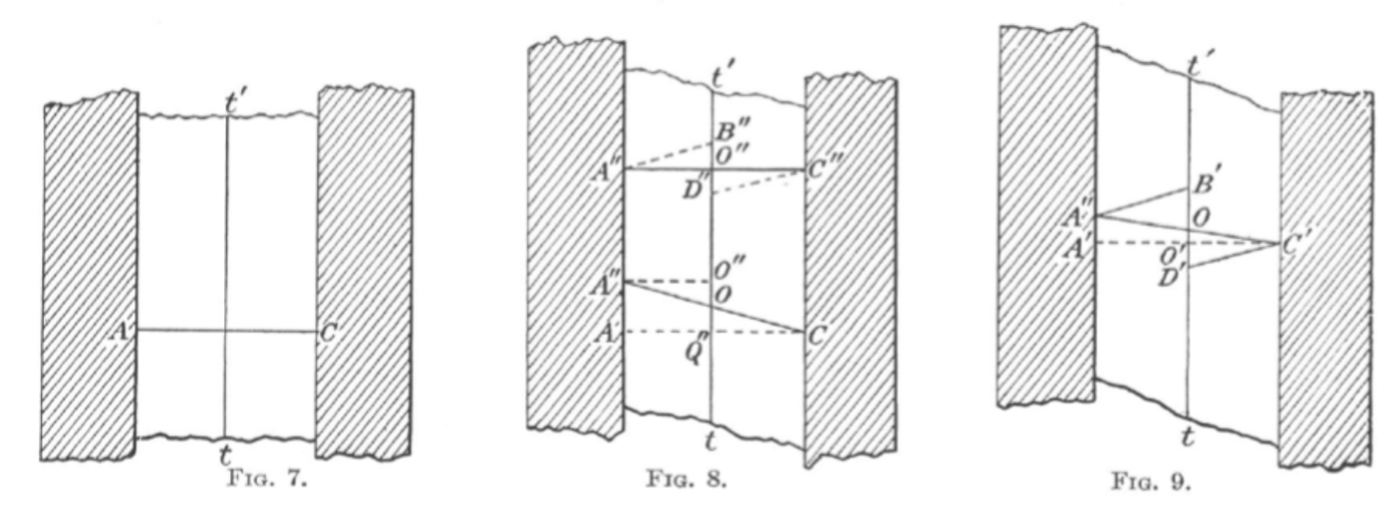
Many crustal deformation processes are elastic
…such as deformation before and during the 1906 San Francisco earthquake
Reid, 1910

Slide 13
Elastic half space models
Elastic half space => semi-infinite isotropic elastic solid
Geological structure embedded in half space

Slide 14
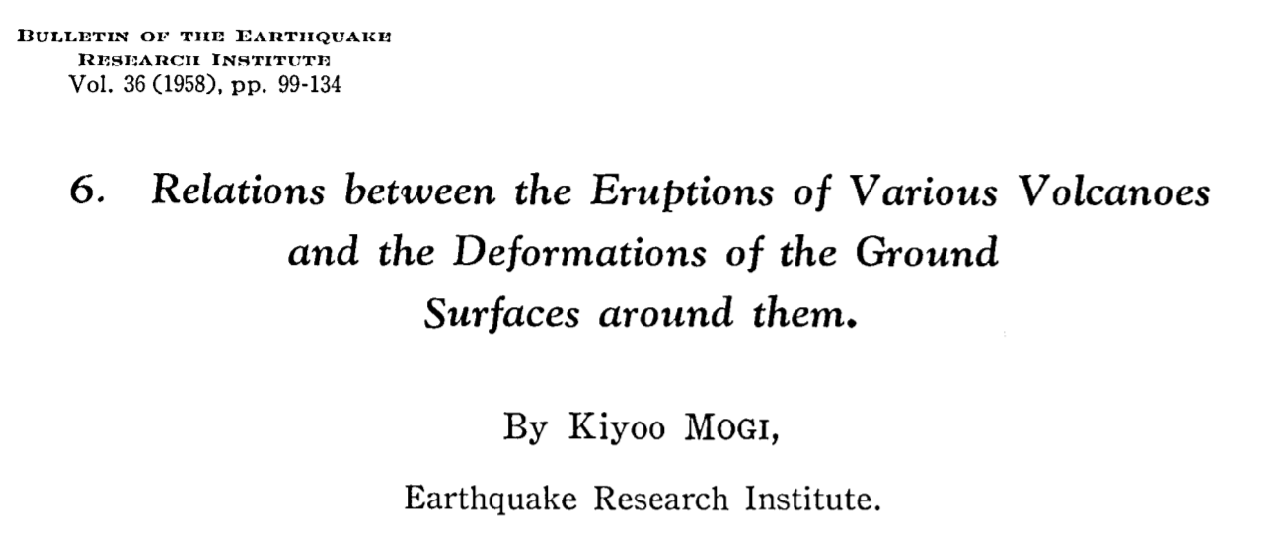
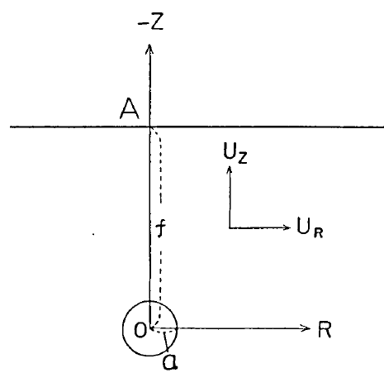
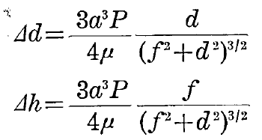
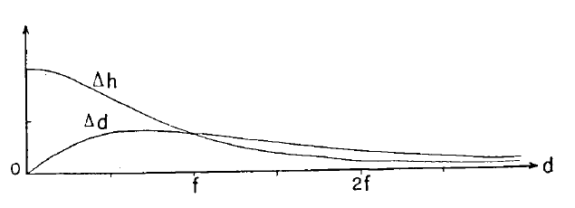
The Mogi model
Spherical pressure/volume change source (e.g. for magma chambers)
The good
Simple model, very quick to compute
The bad
Makes certain simplifying assumptions (isotropic half space, incompressible magma, source radius ≪ depth)

Slide 15
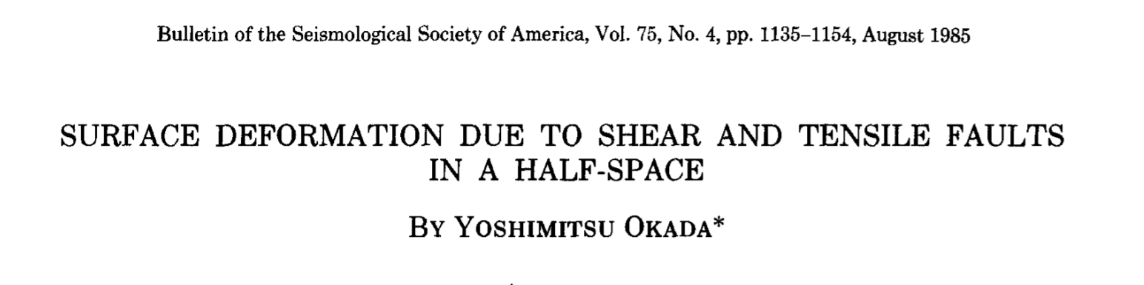
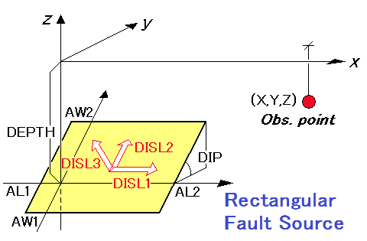
The Okada model
General solution for rectangular (1985) and point (1992) sources in an elastic half space
Pros
Analytical solution, fast to compute
Can model shear (fault slip) and opening (dike or sill intrusion/collapse)
Cons
Again, simplifying assumptions are not necessarily realistic
Cannot tesselate into complex surfaces

Slide 16
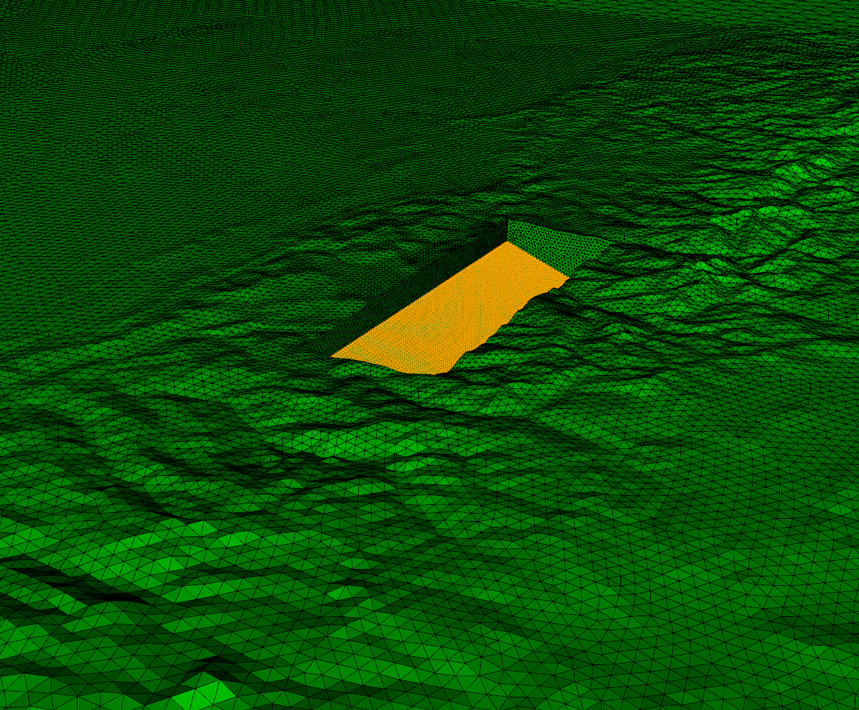
Finite element models (FEMs)
Can compute displacements and stresses for generalized solids and sources
Good
Can incorporate heterogeneous material properties, nonplanar geometries, realistic topography
Can incorporate more complex rheologies (e.g. viscoelasticity)
Less good
Making meshes is complicated and slow
Computing displacements is expensive (minutes to hours)
Gorkha, Nepal earthquake source region (7 million tetrahedral elements!)

Slide 17
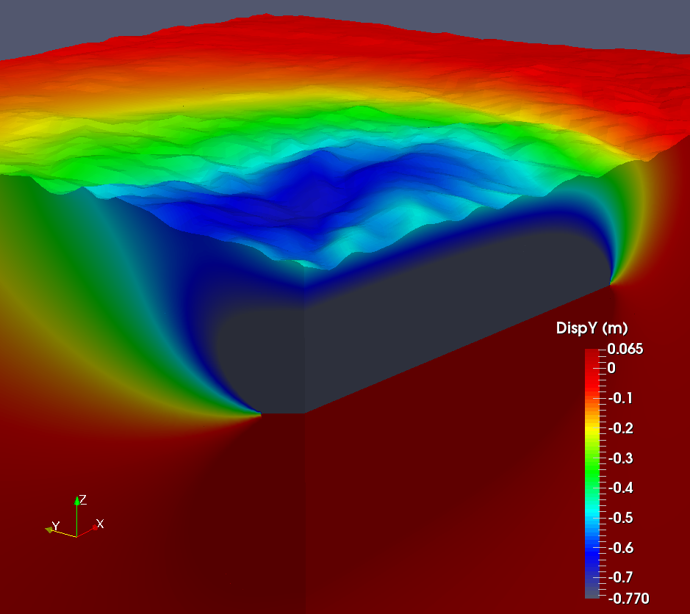
Finite element models (FEMs)
Can compute displacements and stresses for generalized solids and sources
Good
Can incorporate heterogeneous material properties, nonplanar geometries, realistic topography
Can incorporate more complex rheologies (e.g. viscoelasticity)
Less good
Making meshes is complicated and slow
Computing displacements is expensive (minutes to hours)

Slide 18
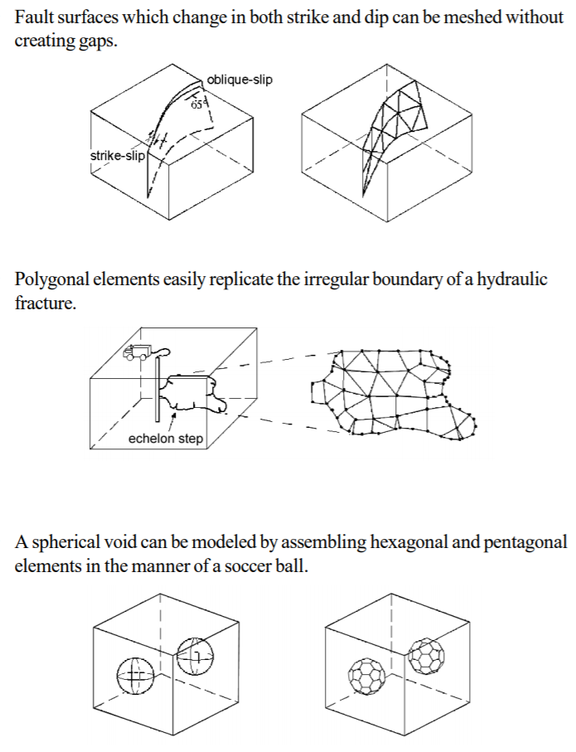
Boundary element models
Numerical method in which quantities are computed on surfaces rather than in volumes
Yay
Faster than FEMs
Polygonal elements can allow complex source geometries
Can compute stresses, use driving stresses
Nay
Does not allow heterogeneous material properties
Slower than analytical codes
poly3d manual

Slide 19
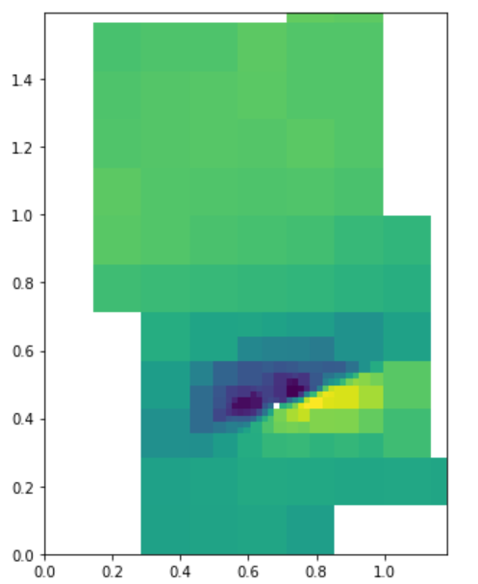
Data downsampling
InSAR data are highly spatially correlated – you do not need every pixel to capture information on a process
Typically more datapoints = longer computation time => downsampling can make modeling more efficient
For example, quadtree decomposition (right) can divide an unwrapped interferogram into a set of regions with similar variance

Slide 20
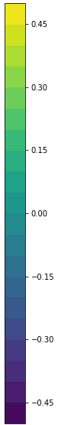
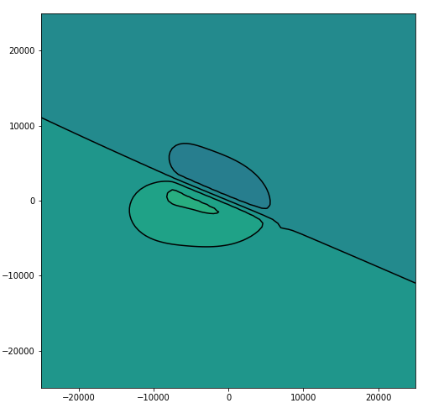
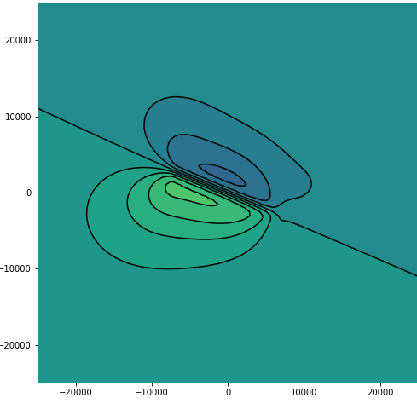
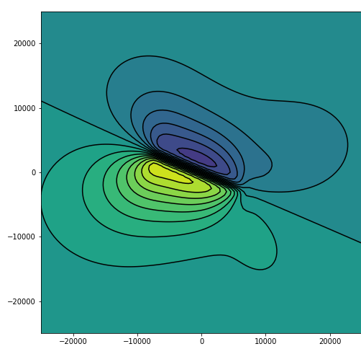
Linear inverse modeling
slip = 0.5 m
If you have
Fixed model geometry
Linear relationship between model parameters and surface displacements
Things are fairly straightforward!
Model simplifies to a matrix inversion problem:
d = G m
m = (G^{T} G)⁻¹ G^{T} d
(G is a matrix of Green’s functions)
slip = 1.0 m
slip = 2.0 m

Slide 21
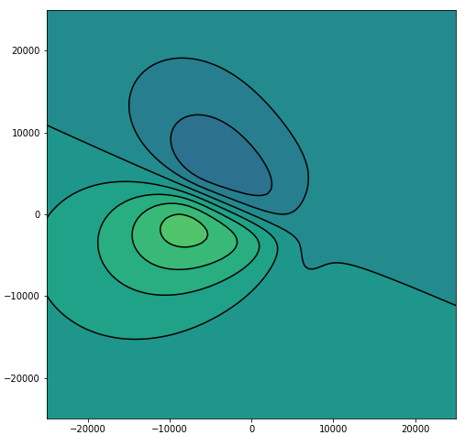
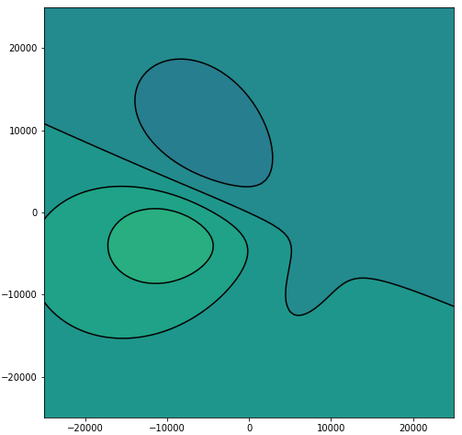
Nonlinear inverse modeling
Unfortunately, not everything has a linear relationship with displacement!
changes in position/depth
changes in dimensions
changes in orientation
In these cases, we may use an optimization approach:
forward model displacements using guessed model parameters
calculate the fit of the forward model to the data
vary the model parameters until a good fit is obtained (e.g. by using an algorithm!)
depth 6 km
depth 9 km
depth 12 km

